Slide 1
Honours Macroeconomics
Business Cycle Theory Topic 4:
Physical Investment Models
and
Financial Investment and Asset Pricing

Slide 2
Plan
Intro
Physical Investment
Static Micro model
Optimal Stock of capital
Dynamic model with some aggregate components
Optimal investment under capital adjustment costs
Financial Investment
Equilibrium Price – Consumption Capital Asset Price Model (CAPM)

Slide 3
Definition of Capital
For the first part of the lecture we mean physical capital
Physical object
Can be used (with other inputs) to produce more physical objects (for consumption or capital)
Can be used repeatedly/accumulated to some extent
NOT financial capital
In banking and finance “capital” often refers to the level of equity of an institution.
Important Categories:
Business fixed investment
Inventory investment
Residential investment

Slide 4
Reasons for studying investment
Investment measured as part of GDP:
Y = C + I + G
Last week we gave formal, dynamic structure to consumption and hence the supply of saving, now we study the other side: demand for investment.
2 main reasons:
Investment matters for the long-run prosperity of a society
Investment matters for the short-run, i.e. the business cycle

Slide 5
In the long-run
Investment is central to the capitalist epoch
Capitalism, with the institutions that make capitalism possible:
Private property
Limited government etc
… incentivizes the accumulation of capital, which, in turn, allows the process of specialization and trade to occur which lies at the heart of the industrial revolution

Slide 7
Investment and observed economic progress
Those regions where investment has lagged has remain underdeveloped
Falling investment rates in SSA during the 1970s, 80s and 90s
And increasing share thereof by government
As well as disinvestment from SSA
All of these were correlated with SSA’s lost decades. The subsequent reversal of fortunes in many African countries have been associated with a return of investment as well

Slide 9
Why limited government?

Slide 10
Why limited government?
Investment as the I in the equation Y = C + I + G
Japan’s lost decades

Slide 11
Investment matters in the short run
A second reason for studying the systematic factors affecting investment spending is its significant influence on the business cycle.
Even though investment expenditure is far smaller in relation to the GDP when compared with consumption expenditure, investment is far more volatile, which adds up to a greater influence on the expansionary and contractionary phases of economic activity

Slide 14
Useful diagnostic/descriptive tool
Research by Prof Stan du Plessis

Slide 15
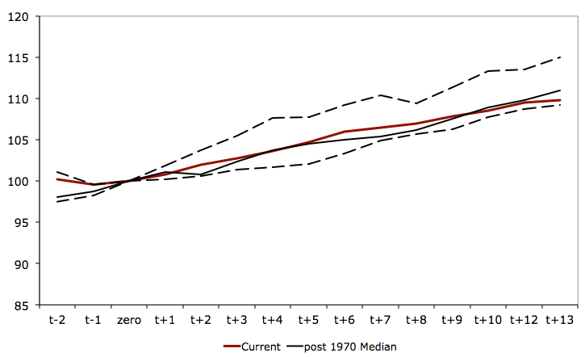
13 Quarters into a weak upswing
Real GDP based to 100 at the trough

Slide 16
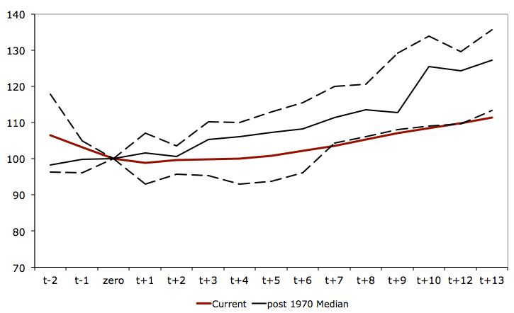
With investment one major constraint
Real Investment based to 100 at the trough

Slide 17
Static Microeconomic model of firm capital stock choice
Baseline

Slide 18
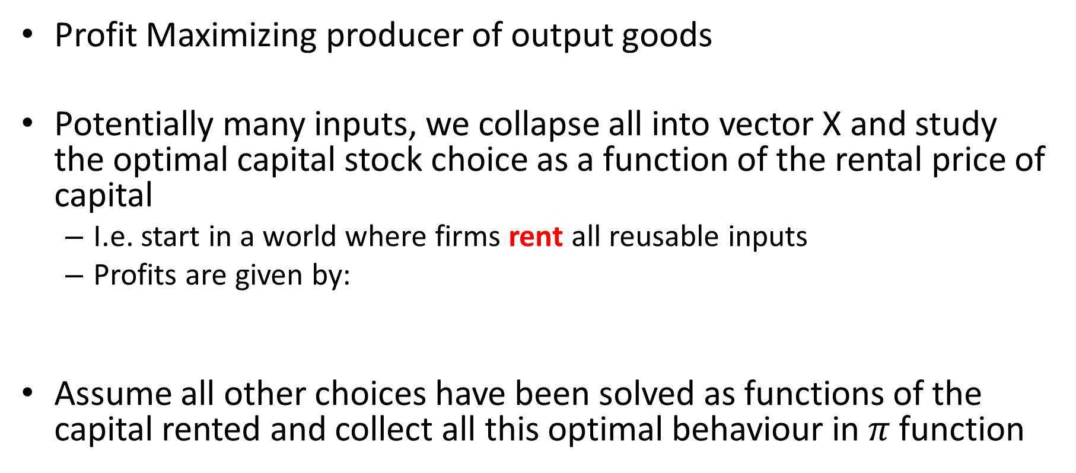
Micro Theory of Firm
Profit Maximizing producer of output goods
Potentially many inputs, we collapse all into vector X and study the optimal capital stock choice as a function of the rental price of capital
I.e. start in a world where firms rent all reusable inputs
Profits are given by:
Assume all other choices have been solved as functions of the capital rented and collect all this optimal behaviour in $π$ function

Slide 19
Micro Theory of Firm
Desired level of capital:
Only a max if:
This will hold if, e.g. there are diminishing marginal returns to capital

Slide 20
Micro Theory of Firm
How does optimal level of capital depend on the rental rate?

Slide 21
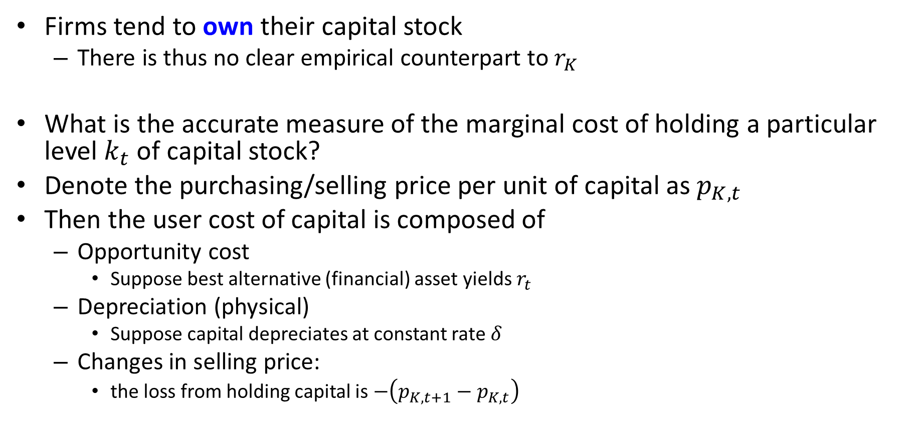
From rental to user cost of capital
Firms tend to own their capital stock
There is thus no clear empirical counterpart to $r_{K}$
What is the accurate measure of the marginal cost of holding a particular level $k_{t}$ of capital stock?
Denote the purchasing/selling price per unit of capital as $p_{K,t}$
Then the user cost of capital is composed of
Opportunity cost
Suppose best alternative (financial) asset yields $r_{t}$
Depreciation (physical)
Suppose capital depreciates at constant rate $δ$
Changes in selling price:
the loss from holding capital is $−\left(p_{K,t+1}−p_{K,t}\right)$

Slide 22
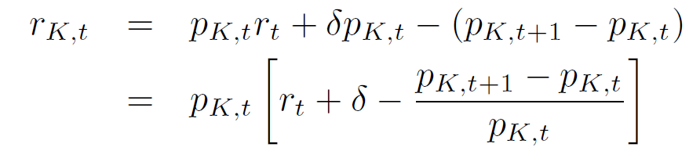
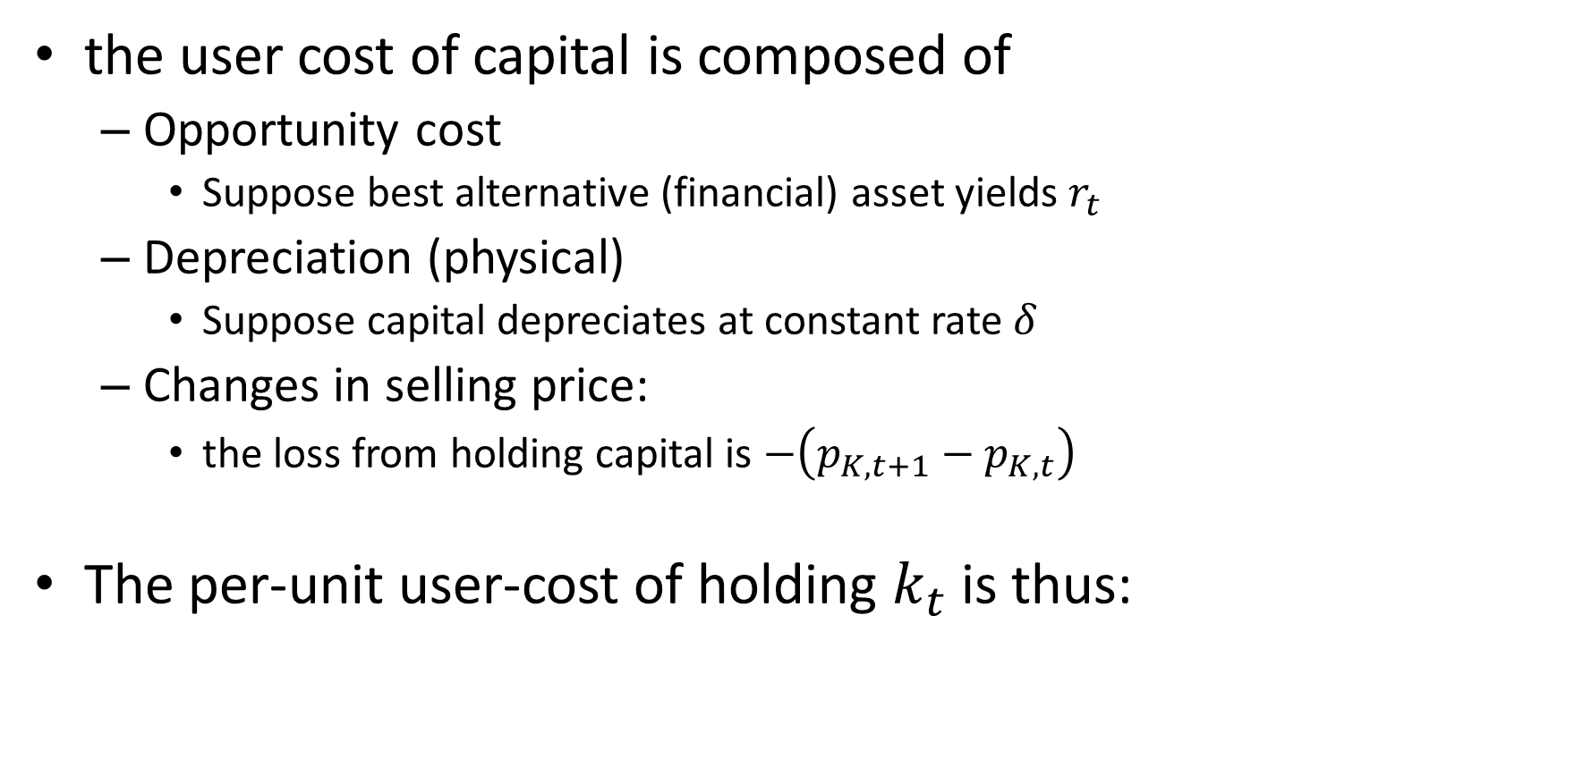
From rental to user cost of capital
the user cost of capital is composed of
Opportunity cost
Suppose best alternative (financial) asset yields $r_{t}$
Depreciation (physical)
Suppose capital depreciates at constant rate $δ$
Changes in selling price:
the loss from holding capital is $−\left(p_{K,t+1}−p_{K,t}\right)$
The per-unit user-cost of holding $k_{t}$ is thus:

Slide 23
Problems with Baseline Model as a description of a dynamic problem
Abstracts from time
Capital adjustment implicitly assumed to be Instantaneous, Costless (after rental cost)
Consider discrete changes in rental/user cost:
E.g. Interest rate variations
Jumping to new desired capital stock implies an infinite rate of adjustment (in continuous time)
Also implies that for every (e.g. daily) change in the interest rate, the capital stock is adjusted
This is not like the real world:
Ignores physical supply constraints
Physical Capital takes time to adjust (think electricity plants)

Slide 24
Problems with Baseline Model as a description of a dynamic problem
Abstracts from time
Abstracts from uncertainty
Model sets current marginal revenue product equal to current marginal user cost period by period
Empirically and practically, it is the lifetime effect of accumulation we are interested in so it should enter the decision
We won’t get to uncertainty today, but Romer shows how and the changes are not surprising

Slide 25
Dynamics of firm capital stock choice with some aggregation
Adjustment Costs

Slide 26
Key modelling device
Costly to adjust capital stock from current level
Meant to capture time effects exogenously
Internal vs External adjustment costs
pictures

Slide 27
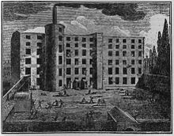
Internal adjustment costs
A steam driven mule spinning mill from Victorian Manchester
Adopting electricity to power factories involved new structural design of buildings (internal adjustment costs)

Slide 28
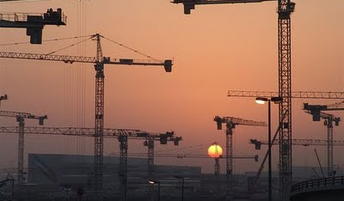
External adjustment costs: Before the financial crisis, one quarter of the world’s construction cranes were in Dubai
Before the financial crisis one quarter of the world’s construction cranes were in Dubai
Definitely reusable productive capital
Consider flying vs shipping them elsewhere

Slide 29
Control, State and Co-state variables vs Parameters
Dynamic optimization problems are often described in the following language:
Parameters are fixed descriptors of the nature of the problem/structure of the economy
Elasticity of output to capital
Depreciation rate
Control variables, are those that the decision maker can choose the level of (also called jump variables)
Investment
State and co-state variables can be exogenous, or endogenous, but not directly controllable. They evolve due to choices of control variables, stochastic shocks and laws of motion/accumulation
State variable: Capital level
Co-state variable: shadow price of capital

Slide 30
Internal Adjustment Costs
Our model will use internal adjustment costs
Additional costs proportional to some function of the size of the change in the capital stock
Romer shows the continuous time version
This allows analysis via phase diagrams as in the RCK model
We will use a discrete time version and find the continuous time version as a limit

Slide 31
The Model Economy
N firms
Each small enough to ignore its impact on the aggregate level of capital
Firms produce a homogenous good with a downward sloping demand curve
No firm is large enough to produce a substantial fraction of the market demand at any price
Production linear in own capital, diminishing returns to aggregate capital
Zero depreciation rate
Constant interest rate on financial assets

Slide 32
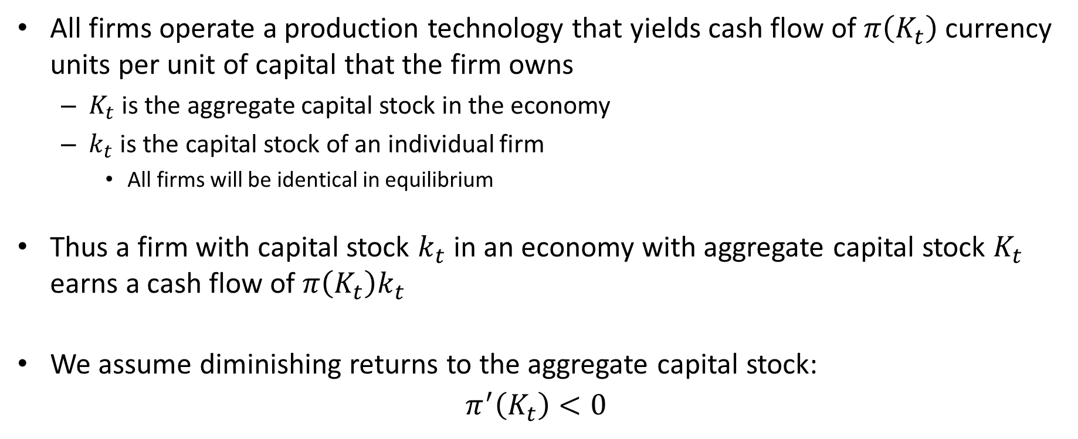
Production Technology
All firms operate a production technology that yields cash flow of $π\left(K_{t}\right)$ currency units per unit of capital that the firm owns
$K_{t}$ is the aggregate capital stock in the economy
$k_{t}$ is the capital stock of an individual firm
All firms will be identical in equilibrium
Thus a firm with capital stock $k_{t}$ in an economy with aggregate capital stock $K_{t}$ earns a cash flow of $π\left(K_{t}\right)k_{t}$
We assume diminishing returns to the aggregate capital stock:
$$π^{′}\left(K_{t}\right)<0$$

Slide 33
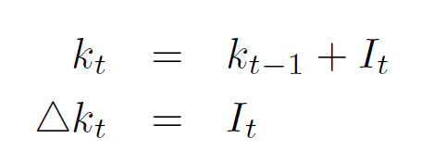
Capital Accumulation
Since we assume a zero depreciation:
Note that this convention means that current investment is available for current production
This goes against the time-to-build argument
Gives a simpler model
Making current production depend on older capital stock will not materially affect the model, especially in continuous time

Slide 34
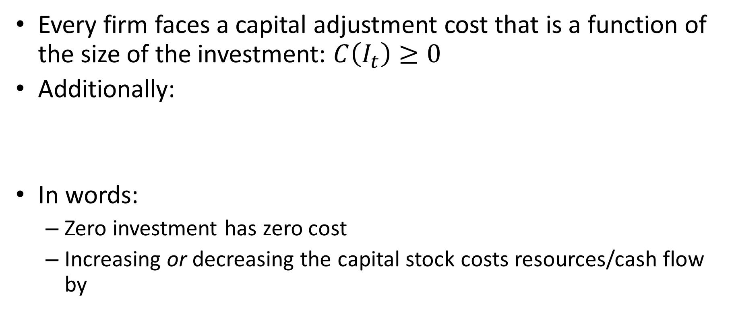
Capital Adjustment Costs
Every firm faces a capital adjustment cost that is a function of the size of the investment: $C\left(I_{t}\right)≥0$
Additionally:
In words:
Zero investment has zero cost
Increasing or decreasing the capital stock costs resources/cash flow by

Slide 35






Capital Adjustment Costs - Example
$$C\left(I_{t}\right)=aI_{t}^{2}$$
$$C^{′}\left(I_{t}\right)=2aI_{t}$$
$$I_{t}$$
$$I_{t}$$
$$0$$
$$0$$

Slide 36
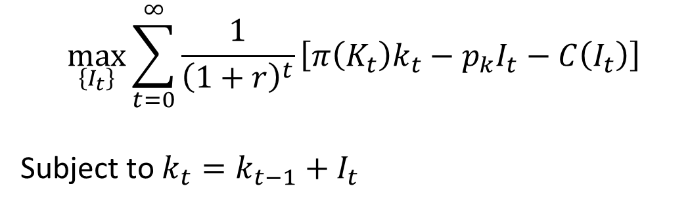
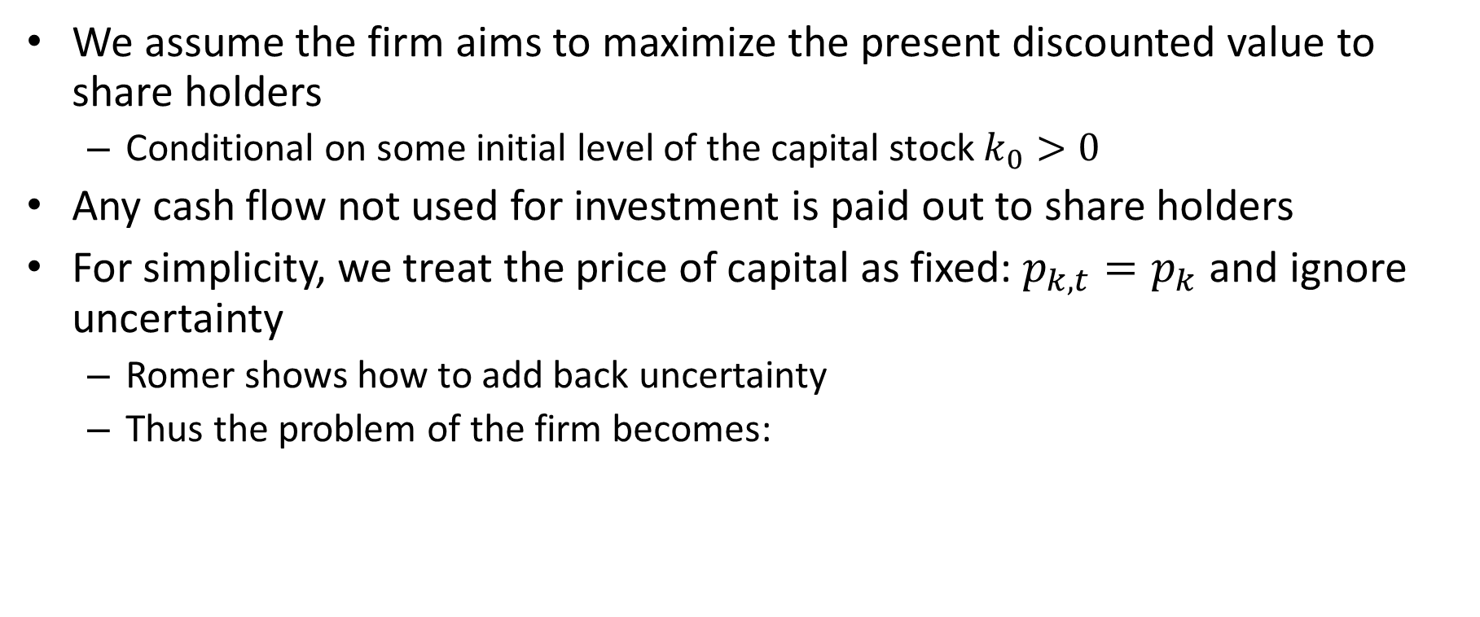
Firm Problem
We assume the firm aims to maximize the present discounted value to share holders
Conditional on some initial level of the capital stock $k_{0}>0$
Any cash flow not used for investment is paid out to share holders
For simplicity, we treat the price of capital as fixed: $p_{k,t}=p_{k}$ and ignore uncertainty
Romer shows how to add back uncertainty
Thus the problem of the firm becomes:
$$\max_{\left\{I_{t}\right\}}{\sum_{t=0}^{∞}{\frac{1}{{\left(1+r\right)}^{t}}\left[π\left(K_{t}\right)k_{t}−p_{k}I_{t}−C\left(I_{t}\right)\right]}}$$
Subject to $k_{t}=k_{t−1}+I_{t}$

Slide 37
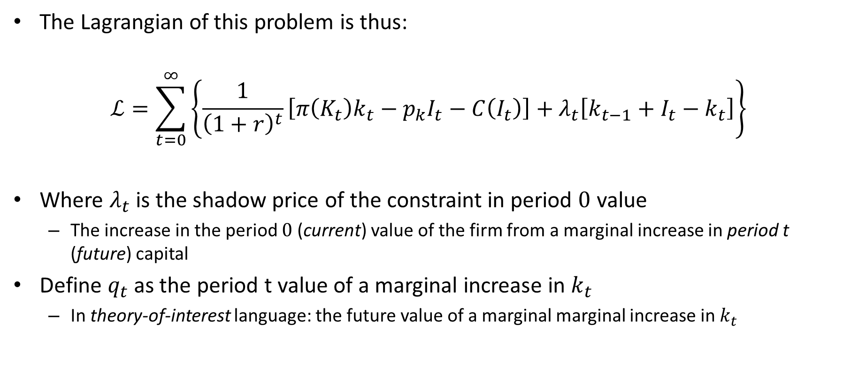
Firm Problem
The Lagrangian of this problem is thus:
$$ℒ=\sum_{t=0}^{∞}{\left\{\frac{1}{{\left(1+r\right)}^{t}}\left[π\left(K_{t}\right)k_{t}−p_{k}I_{t}−C\left(I_{t}\right)\right]+λ_{t}\left[k_{t−1}+I_{t}−k_{t}\right]\right\}}$$
Where $λ_{t}$ is the shadow price of the constraint in period $0$ value
The increase in the period $0$ (current) value of the firm from a marginal increase in period t (future) capital
Define $q_{t}$ as the period t value of a marginal increase in $k_{t}$
In theory-of-interest language: the future value of a marginal marginal increase in $k_{t}$

Slide 38

Firm Problem
The Lagrangian of this problem becomes:
$$ℒ=\sum_{t=0}^{∞}{\frac{1}{{\left(1+r\right)}^{t}}\left\{\left[π\left(K_{t}\right)k_{t}−p_{k}I_{t}−C\left(I_{t}\right)\right]+q_{t}\left[k_{t−1}+I_{t}−k_{t}\right]\right\}}$$
$q_{t}$ is one of those “named” concepts: “Tobin’s Q”

Slide 39
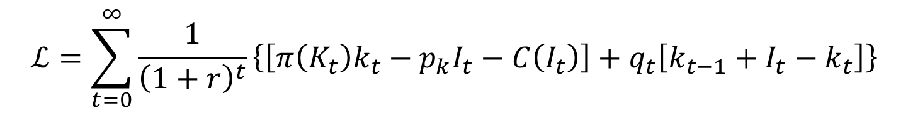

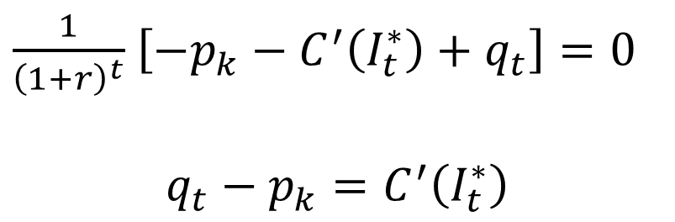

Optimal Choices
$$ℒ=\sum_{t=0}^{∞}{\frac{1}{{\left(1+r\right)}^{t}}\left\{\left[π\left(K_{t}\right)k_{t}−p_{k}I_{t}−C\left(I_{t}\right)\right]+q_{t}\left[k_{t−1}+I_{t}−k_{t}\right]\right\}}$$
First order conditions:
Interpretation:
If $q_{t}=p_{k}$, the level of capital is optimal, so the optimal investment is zero
If $q_{t}<p_{k}$, the level of capital should be decreased, or $I_{t}^{∗}<1$
If $q_{t}>p_{k}$, the level of capital should be increased, or $I_{t}^{∗}>1$
$$\frac{∂ℒ}{∂I_{t}}=0$$
$\frac{1}{{\left(1+r\right)}^{t}}$ $\left[−p_{k}−C^{′}\left(I_{t}^{∗}\right)+q_{t}\right]=0$
$$q_{t}−p_{k}=C^{′}\left(I_{t}^{∗}\right)$$

Slide 40
Optimal Choices
$$ℒ=\sum_{t=0}^{∞}{\frac{1}{{\left(1+r\right)}^{t}}\left\{\left[π\left(K_{t}\right)k_{t}−p_{k}I_{t}−C\left(I_{t}\right)\right]+q_{t}\left[k_{t−1}+I_{t}−k_{t}\right]\right\}}$$
First order conditions:
Interpretation:
The LHS is the marginal revenue product of capital, the RHS the dynamic marginal user cost of capital

Slide 41
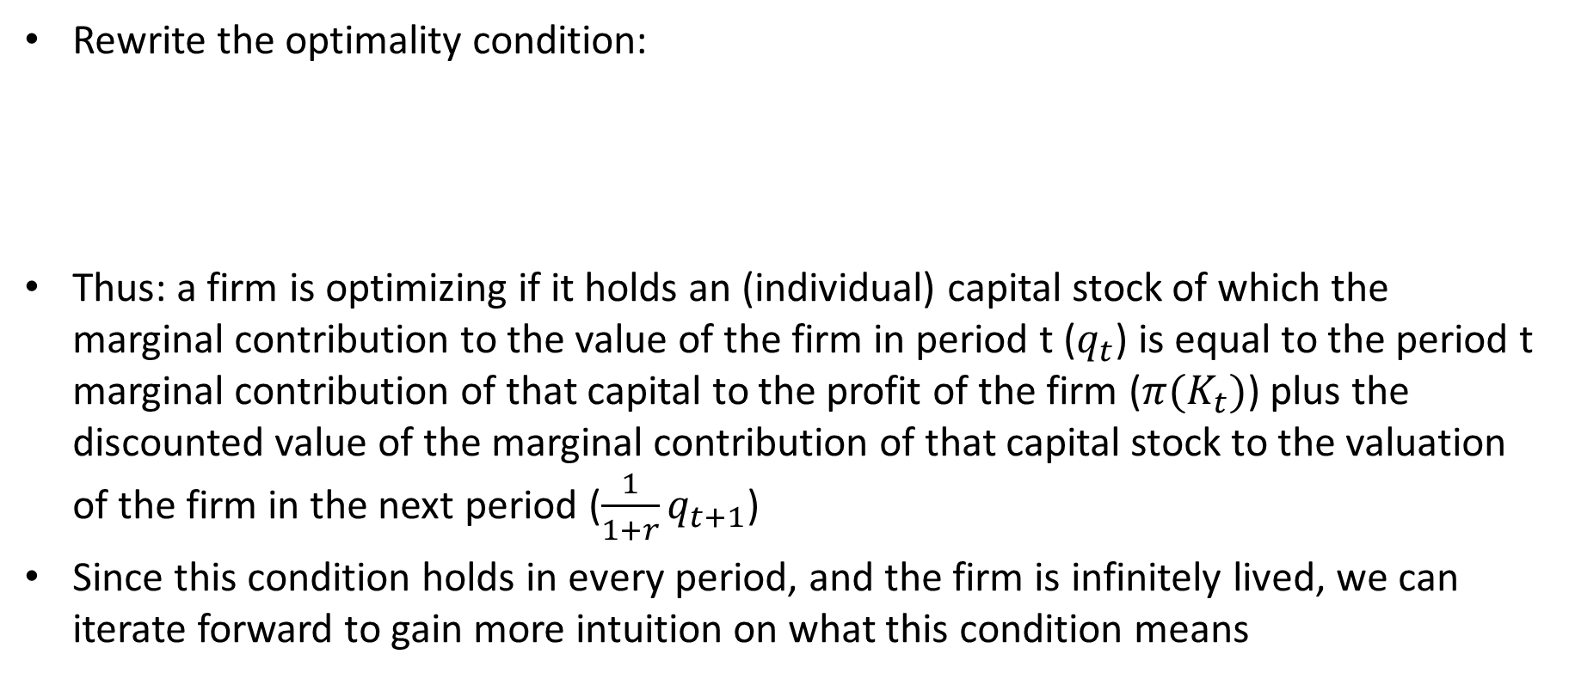
Interpretation of q
Rewrite the optimality condition:
Thus: a firm is optimizing if it holds an (individual) capital stock of which the marginal contribution to the value of the firm in period t ($q_{t}$) is equal to the period t marginal contribution of that capital to the profit of the firm (${π(K}_{t})$) plus the discounted value of the marginal contribution of that capital stock to the valuation of the firm in the next period ($\frac{1}{1+r}q_{t+1}$)
Since this condition holds in every period, and the firm is infinitely lived, we can iterate forward to gain more intuition on what this condition means

Slide 42
Interpretation of q
Iterating forward:

Slide 43

Interpretation of q
In the limit as $T→∞$
Thus, for $q_{t}$ to be the marginal contribution of capital in period t to the value of the firm in period t, we must have:
This is called a transversality condition, which is a feature of any well defined infinite time optimization problem

Slide 44

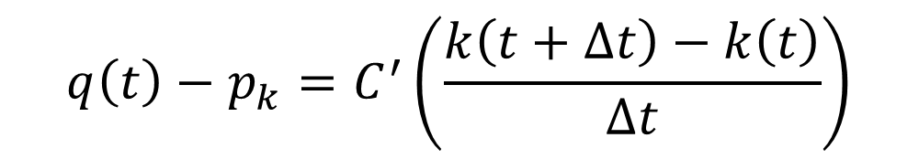
Moving to a continuous time model
The optimality conditions of the discrete time model were:
Rescaling them for time jumps of $△t$ rather than 1:
Taking the limit as $△t→0$ yields?
$$q\left(t\right)−p_{k}=C^{′}\left(I_{t}\right)$$
$$q\left(t\right)−p_{k}=C^{′}\left(\frac{k\left(t+∆t\right)−k\left(t\right)}{∆t}\right)$$

Slide 45

Moving to a continuous time model
Maybe more familiar notation will help?
$$\lim_{h→0}\frac{f\left(x+h\right)−f(x)}{h}$$
The optimality conditions of the discrete time model were:
Rescaling them for time jumps of $△t$ rather than 1:
Taking the limit as $△t→0$ yields?
$$q\left(t\right)−p_{k}=C^{′}\left(I_{t}\right)$$
$$q\left(t\right)−p_{k}=C^{′}\left(\frac{k\left(t+∆t\right)−k\left(t\right)}{∆t}\right)$$

Slide 46

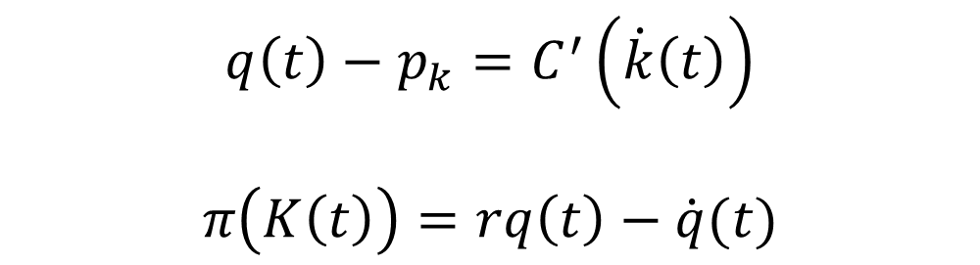
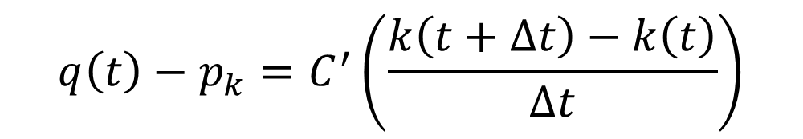
Moving to a continuous time model
Rescaling them for time jumps of $△t$ rather than 1:
Taking the limit as $△t→0$ yields:
$$q\left(t\right)−p_{k}=C^{′}\left(\frac{k\left(t+∆t\right)−k\left(t\right)}{∆t}\right)$$
$$q\left(t\right)−p_{k}=C^{′}\left(\dot{k}\left(t\right)\right)$$
$$π\left(K\left(t\right)\right)=rq\left(t\right)−\dot{q}(t)$$

Slide 47
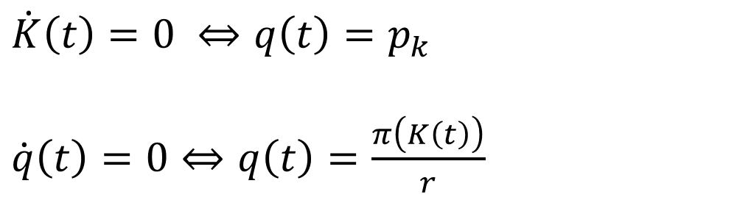
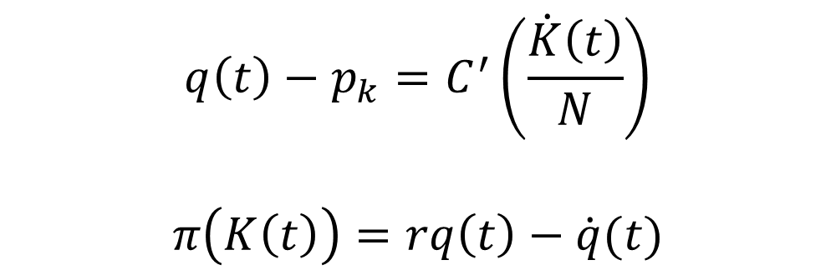
Equilibrium
$$q\left(t\right)−p_{k}=C^{′}\left(\frac{\dot{K}\left(t\right)}{N}\right)$$
$$π\left(K\left(t\right)\right)=rq\left(t\right)−\dot{q}(t)$$
In equilibrium, all firms act the same, so:
The zero loci are given by:
$\dot{K}\left(t\right)=0 ⇔q\left(t\right)=p_{k}$
$\dot{q}\left(t\right)=0⇔q\left(t\right)=\frac{π\left(K\left(t\right)\right)}{r}$

Slide 48
Phase Diagram in q,K space
q
K

Slide 49


$\dot{K}\left(t\right)=0$locus
q
$\dot{K}\left(t\right)=0 ⇔q\left(t\right)=p_{k}$
K

Slide 50


$\dot{K}\left(t\right)=0$locus
q
$\dot{K}\left(t\right)=0 ⇔q\left(t\right)=p_{k}$
$$p_{k}$$
$$\dot{K}=0$$
K

Slide 51



$\dot{K}\left(t\right)=0$locus
q
$$q\left(t\right)−p_{k}=C^{′}\left(\frac{\dot{K}\left(t\right)}{N}\right)$$
$$\dot{K}>0$$
$$p_{k}$$
$$\dot{K}=0$$
$$\dot{K}<0$$
K

Slide 52
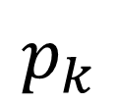
$\dot{K}\left(t\right)=0$locus
q
$$p_{k}$$
$$\dot{K}=0$$
K

Slide 53

$\dot{q}=0$ locus
q
K

Slide 54

$\dot{q}=0$ locus
q
$$\dot{q}=0$$
K

Slide 55



[$\dot{q}=0$] Locus
q
$$\dot{q}>0$$
$$\dot{q}<0$$
$$\dot{q}=0$$
K

Slide 56
[$\dot{q}=0$] Locus
q
$$\dot{q}=0$$
K

Slide 57
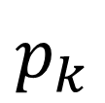
Phase Diagram of Dynamics
q
$$p_{k}$$
$$\dot{K}=0$$
$$\dot{q}=0$$
K

Slide 58

Non-equilibrium paths (with fixed loci)
q
$$p_{k}$$
$$\dot{K}=0$$
$$\dot{q}=0$$
$$K^{∗}$$
K

Slide 59
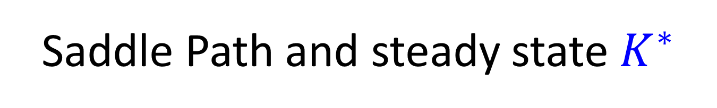
Saddle Path and steady state $K^{∗}$
q
$$p_{k}$$
$$\dot{K}=0$$
$$\dot{q}=0$$
$$K^{∗}$$
K

Slide 60
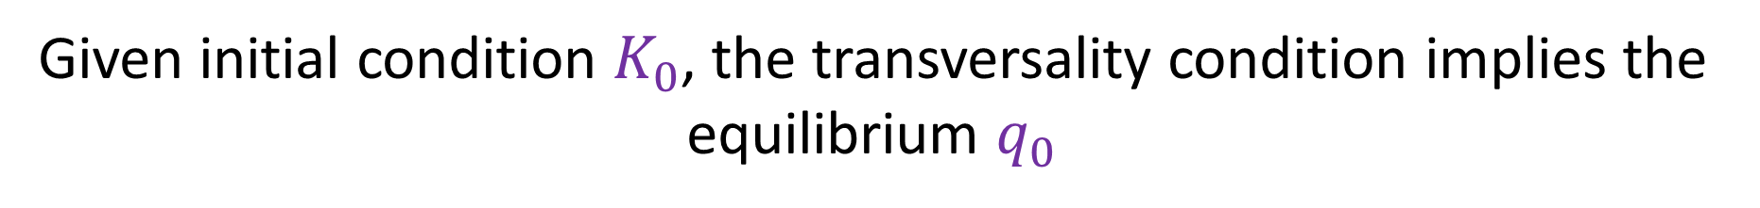


Given initial condition $K_{0}$, the transversality condition implies the equilibrium $q_{0}$
q
$$q_{0}$$
$$p_{k}$$
$$\dot{K}=0$$
$$\dot{q}=0$$
$$K_{0}$$
K

Slide 61
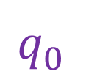

Given initial condition $K_{0}$, the transversality condition implies the equilibrium $q_{0}$
q
$$p_{k}$$
$$\dot{K}=0$$
$$q_{0}^{}$$
$$\dot{q}=0$$
$$K_{0}$$
K

Slide 62
Impact of exogenous shocks
Now we have the tools to analyse the model’s predictions of outcomes when shocks disturb the steady state
It is crucial to distinguish between
Permanent and Temporary Shocks
Anticipated and Unanticipated Shocks

Slide 63
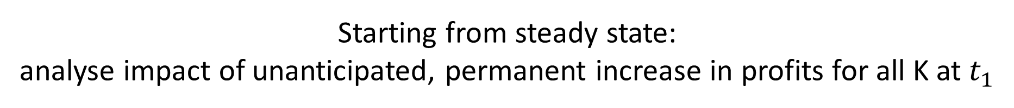
Starting from steady state: analyse impact of unanticipated, permanent increase in profits for all K at $t_{1}$
q
$$p_{k}$$
$$\dot{K}=0$$
$$\dot{q}=0$$
$$K^{∗}$$
K

Slide 64
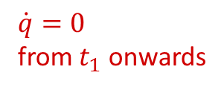
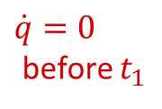




an unanticipated increase in $π\left(K\left(t\right)\right)$ shifts the $\dot{q}\left(t\right)$ locus up at $t_{1}$
q
$$p_{k}$$
$$\dot{K}=0$$
$\dot{q}=0$ from $t_{1}$ onwards
$\dot{q}=0$ before $t_{1}$
$$K_{old}^{∗}$$
$$K_{new}^{∗}$$
K

Slide 65
Thus the new saddle path is:
q
$$p_{k}$$
$$\dot{K}=0$$
$\dot{q}=0$ from $t_{1}$ onwards
$\dot{q}=0$ before $t_{1}$
$$K_{old}^{∗}$$
$$K_{new}^{∗}$$
K

Slide 66
The equilibrium must end up at a new steady state, therefore the dynamic path is:
q
$$p_{k}$$
$$\dot{K}=0$$
$\dot{q}=0$ from $t_{1}$ onwards
$\dot{q}=0$ before $t_{1}$
$$K_{old}^{∗}$$
$$K_{new}^{∗}$$
K

Slide 67


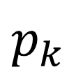

Dynamic Paths
q
$$p_{k}$$
t
K
$$K_{new}^{∗}$$
$$K_{old}^{∗}$$
t
$$t_{1}$$

Slide 68


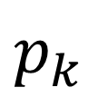


Starting from steady state: analyse impact of unanticipated, temporary subsidy $τ$ that reduces the price of capital between $t_{1}$ and $t_{2}$
q
$$p_{k}$$
$$\dot{K}=0$$
$$\dot{q}=0$$
$$K_{old}^{∗}$$
K

Slide 69
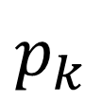
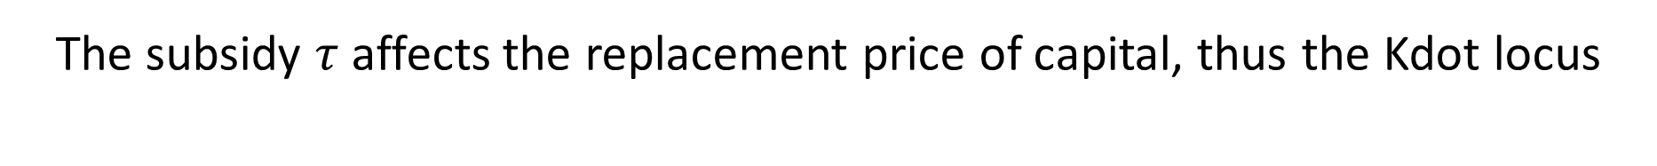
The subsidy $τ$ affects the replacement price of capital, thus the Kdot locus
q
$\dot{K}\left(t\right)=0 ⇔q\left(t\right)=p_{k}$
$$p_{k}$$
$$\dot{K}=0$$
$$\dot{q}=0$$
$$K_{old}^{∗}$$
K

Slide 70
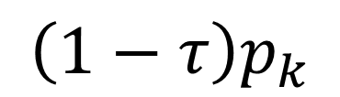
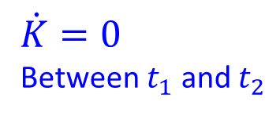

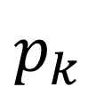
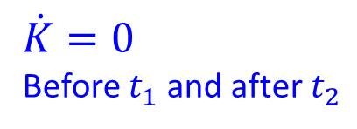
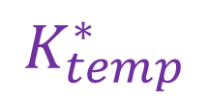
The subsidy $τ$ affects the replacement price of capital, thus the Kdot locus
q
$$p_{k}$$
$$\dot{K}=0$$
Before $t_{1}$ and after $t_{2}$
$$\left(1−τ\right)p_{k}$$
$$\dot{K}=0$$
Between $t_{1}$ and $t_{2}$
$$\dot{q}=0$$
$$K_{}^{∗}$$
$$K_{temp}^{∗}$$
K

Slide 71
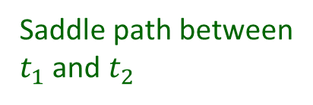

The subsidy $τ$ affects the replacement price of capital, thus the Kdot locus
q
$$p_{k}$$
Saddle path from $t_{2}$
$$\left(1−τ\right)p_{k}$$
Saddle path between $t_{1}$ and $t_{2}$
$$K_{}^{∗}$$
$$K_{temp}^{∗}$$
K

Slide 72
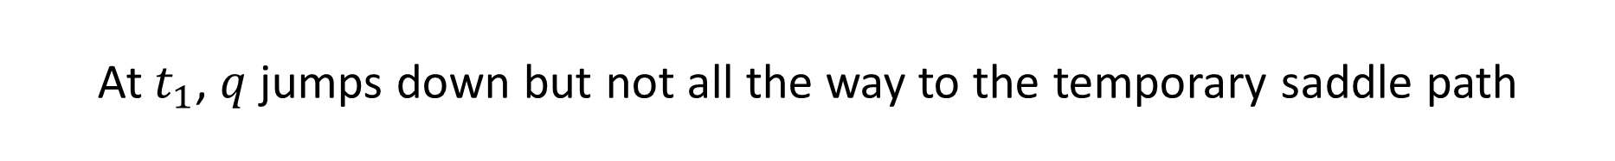
At $t_{1}$, $q$ jumps down but not all the way to the temporary saddle path
q
$$p_{k}$$
Saddle path from $t_{2}$
$$\left(1−τ\right)p_{k}$$
Saddle path between $t_{1}$ and $t_{2}$
$$K_{}^{∗}$$
$$K_{temp}^{∗}$$
K

Slide 73
The dynamics are governed by the temporary loci
q
$$p_{k}$$
Saddle path from $t_{2}$
$$\left(1−τ\right)p_{k}$$
Saddle path between $t_{1}$ and $t_{2}$
$$K_{}^{∗}$$
$$K_{temp}^{∗}$$
K

Slide 74

At $t_{2}$ the system hits the old saddle path, and converges to the original steady state
q
$$p_{k}$$
Saddle path from $t_{2}$
$$\left(1−τ\right)p_{k}$$
Saddle path between $t_{1}$ and $t_{2}$
$$K_{}^{∗}$$
$$K_{temp}^{∗}$$
K

Slide 75





q
$$p_{k}$$
$$\left(1−τ\right)p_{k}$$
t
K
$$K_{temp}^{∗}$$
$$K_{}^{∗}$$
t
$$t_{1}$$
$$t_{2}$$

Slide 76
Empirically
Aggregate measurement issues confound simple tests of the model
Difficult to measure marginal q
Easy to measure average q
They are likely to differ in crucial ways
In situations where changes in marginal q can be identified (natural experiments)
Theory seems to hold promise

Slide 77
In current research
As in the consumption case, it is no longer standard to consider investment on its own.
The key modelling devices we discussed are present in all DSGE models
The marginal value of investment becomes a key ingredient of models of crises

Slide 78
I.e. when asset prices (q) of real assets have bubble equilibria
The Global Financial Crisis can be read as a case where the marginal value of investment in US housing market had an endogenous bubble
Can be loosely modelled as a mistaken belief that the future path of cash flows from housing being higher than it truly turned out to be
Temporarily being off equilibrium so that q and K jointly grow
However, with the additional welfare relevant fact that these resources could have been elsewhere invested
7 year build-up of global misallocated resources – large cost
Drop in output = “revaluation of potential output” rather than “temporary shock”

Slide 79

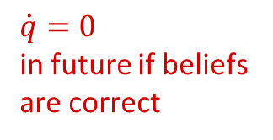


Suppose the general belief is that the future profitability from sub-prime mortgage housing will be higher:
q
$$p_{K}$$
$$\dot{K}=0$$
$\dot{q}=0$ initially
$\dot{q}=0$ in future if beliefs
are correct
$$K_{t_{1}}$$
$$K_{new}^{∗}$$
K

Slide 80
But when mortgage repayments begin to drop off, it is revealed that that was an overly optimistic view
q
$$p_{K}$$
$$\dot{K}=0$$
$\dot{q}=0$ initially
$$K_{t_{1}}$$
$$K_{new}^{∗}$$
K

Slide 81









Starting from steady state: impact of an anticipated, permanent tax on investment
q
$${q_{new}^{∗}=\left(1+τ\right)p}_{K}$$
$${\left[\dot{K}=0\right]}_{new}$$
$$q_{t_{2}}$$
$$q_{t_{1}}$$
$$q_{t<t_{1}}=p_{K}$$
$${\left[\dot{K}=0\right]}_{old}$$
$$\dot{q}=0$$
$$K_{new}^{∗}$$
$$K_{t_{1}}$$
$$K_{t_{2}}$$
K

Slide 82
Risky Assets and the Consumption Capital-Asset Pricing Model
Above we considered real investment in physical capital
Another important issue is the investment in financial assets
Be careful in your reading to distinguish these as the language is very similar, but the applications are very different

Slide 83
Risky Assets and the Consumption CAPM
Consider a consumer with a concave utility function that can invest in a set of assets, each with with uncertain returns
To avoid “end of life” complications, we assume an infinitely lived agent
Use the calculus of variations approach:
Along the equilibrium path, marginal changes should be utility neutral

Slide 84

Risky Assets and the Consumption CAPM
Let there be a set of assets indexed by $i$
Asset $i$ is described by its
Price in period $t$, $P_{t}^{i}$
Its stream of uncertain future payoffs (dividends), $D_{t+1}^{i},D_{t+2}^{i},…$
A consumer that reduces present consumption $C_{t}$ by a marginal amount $dC$ to buy asset $i$ can purchase $P_{t}^{i}dC$ units of the asset
This reduces her present utility by $u^{′}\left(C_{t}\right)P_{t}^{i}dC$
Future utility increases in all future periods $t+k$ by $u^{′}\left(C_{t+k}\right)D_{t+k}^{i}dC$
If acting optimally, these trade-offs must be equal in equilibrium:

Slide 85
Risky Assets and the Consumption CAPM
If she is acting optimally, these trade-offs must be equal in equilibrium:
If all consumers act in this way, this gives us a prediction of the price of assets in general equilibrium:

Slide 86
Risky Assets and the Consumption CAPM
If she is acting optimally, these trade-offs must be equal in equilibrium:
If all consumers act in this way, this gives us a prediction of the price of assets in general equilibrium:
This term is called the pricing kernel or the stochastic discount factor

Slide 87
Suppose an asset is only held for one period and define the rate of return as
Then we can find an expression for the equilibrium expected return on the asset:

Slide 88
Suppose an asset is only held for one period and define the rate of return as
Then we can find an expression for the equilibrium expected return on the asset:
Now suppose there is a risk free asset, i.e. with a certain future return:
Then the equilibrium excess return of a risky asset is:
Thus the excess return on a risky asset is proportional to the covariance of the returns with consumption. (This is related to the market beta in financial economics)

Slide 89
Suppose a new asset is created
It would be worth changing her portfolio if the asset tends to give high returns in states where her consumption would have been low and vice versa
This suggest that hedging risks is crucial to optimal portfolio selections
Romer’s example: a worker in the US steel industry should be investing in assets that tend to do well when US Steel companies do badly
Such as foreign steel companies or foreign Aluminium companies

Slide 90
Two more puzzles
Home Bias puzzle
There is an overwhelming tendency for investors to be predominantly invested in home country assets, highly correlated with home country events
Equity premium puzzle
We can extend the model to ask what equilibrium prices for assets with different excess returns should be
Typically find that equity is at a premium relative to safer assets that far exceeds the predicted premium for any reasonable degree of risk aversion
Self-study: there will be a 10 mark (10 minute, approx. 2 paragraph) question on these puzzles in the exam

Slide 91








Starting from steady state: impact of an anticipated, permanent increase in r
q
$\dot{q}=0$ from $t_{2}$
$$1$$
$$\dot{K}=0$$
$$q_{t_{1}}$$
$$q_{t_{2}}$$
$\dot{q}=0$ $t_{1}$ to $t_{2}$
$$K_{new}^{∗}$$
$$K_{t_{2}}$$
$$K_{t_{1}}$$
K

Slide 92






Dynamic Paths
q
$$1$$
$$q_{t_{1}}$$
$$q_{t_{2}}$$
t
K
$$K_{t_{1}}$$
$$K_{t_{2}}$$
$$K_{new}^{∗}$$
t
$$t_{1}$$
$$t_{2}$$

